Slide 1


DATA ANALYTICS PROJECT HEALTHCARE Business DOMAIN

Slide 2

"Patient Encounter Cost and Risk Analysis in Healthcare Systems"

Slide 3
Problem Statement
Healthcare organizations face increasing challenges in managing the costs and financial risks associated with patient encounters. Identifying patients with frequent high-cost encounters, analyzing the impact of various medical procedures, and understanding financial risks due to payer coverage gaps are critical for improving operational efficiency and patient outcomes. This project aims to provide a comprehensive analysis of patient encounters, procedure costs, and payer coverage to uncover patterns of high-cost healthcare utilization and potential financial risks.
Through this analysis, healthcare providers will gain actionable insights into patient demographics, procedure trends, and key factors driving uncovered costs. The objective is to support informed decision-making for resource allocation, patient care management, and financial planning by leveraging SQL-based data analysis across key healthcare tables such as encounters, patients, procedures, payers, and organizations.

Slide 4
Business Requirement
Evaluating Financial Risk by Encounter Outcome
Objective:
Determine which ReasonCodes lead to the highest financial risk based on the total uncovered cost (difference between total claim cost and payer coverage). Analyze this by combining patient demographics and encounter outcomes.
Identifying Patients with Frequent High-Cost Encounters
Objective:
Identify patients who had more than 3 encounters in a year where each encounter had a total claim cost above a certain threshold (e.g., $10,000). The query should return the patient details, number of encounters, and the total cost for those encounters.
Identifying Risk Factors Based on Demographics and Encounter Reasons
Objective:
Analyze the top 3 most frequent diagnosis codes (ReasonCodes) and the associated patient demographic data to understand which groups are most affected by high-cost encounters.

Slide 5
Business Requirement
Assessing Payer Contributions for Different Procedure Types
Objective:
Analyze payer contributions for the base cost of procedures and identify any gaps between total claim cost and payer coverage.
Identifying Patients with Multiple Procedures Across Encounters
Objective:
Find patients who had multiple procedures across different encounters with the same ReasonCode.
Analyzing Patient Encounter Duration for Different Classes
Objective:
Calculate the average encounter duration for each class (EncounterClass) per organization, identifying any encounters that exceed 24 hours.

Slide 6
Visual REPORT Requirement
1. Encounter Cost Distribution by Encounter Class
Objective: Analyze the distribution of base and total claim costs across different encounter classes (e.g., ambulatory, emergency, inpatient, wellness, urgent care).
2. High-Cost Patient Identification
Objective: Identify patients with repeated high-cost encounters and highlight their total cost contribution to the healthcare system. This helps in targeting care management for patients with high healthcare utilization.
3. Uncovered Costs by Payer and Reason Code
Objective: Analyze the financial risks due to uncovered costs, focusing on how much each payer is covering versus how much remains uncovered across different diagnosis or reason codes.
4. Procedure Cost Trends and Diagnosis Correlation
Objective: Explore trends in the cost of procedures performed over time and their correlation with specific diagnosis codes or conditions.
5. Geographical Analysis of Encounters by Organization and Cost
Objective: Map healthcare encounters geographically to identify regions or organizations with high patient traffic and high average encounter costs.

Slide 7

TOOLS USED : MS SQL , POWERBI

Slide 8
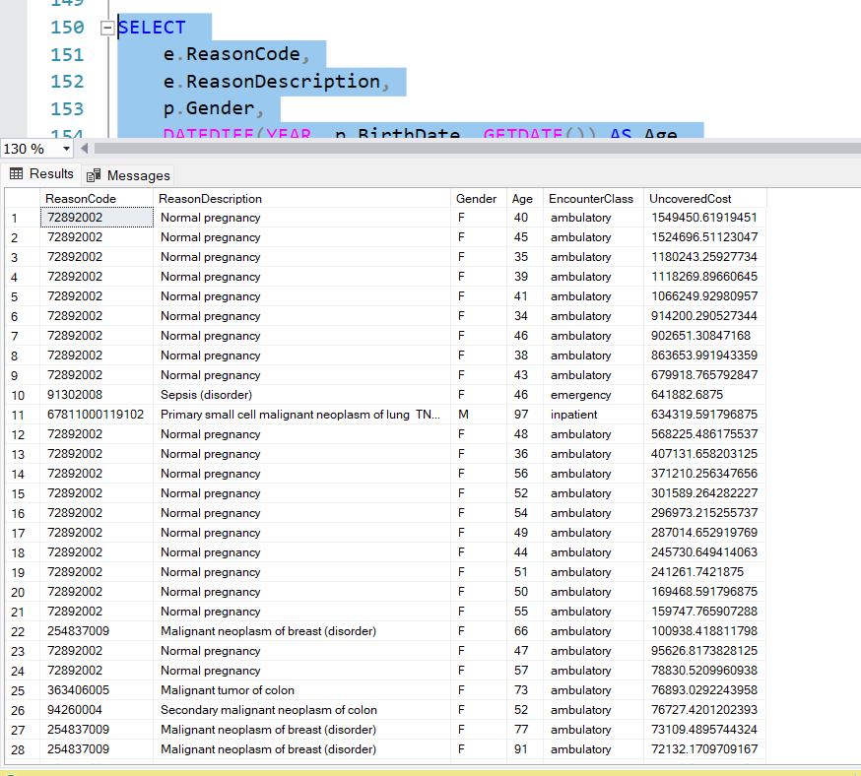
KEY INSIGHTS
1. Evaluating Financial Risk by Encounter Outcome
The highest uncovered costs are linked to the "normal pregnancy" diagnosis (reasoncode: 72892002), seen repeatedly among females aged 35–56, all in ambulatory encounters — totaling over ₹1.5M in several cases.
Other high-risk conditions like sepsis and malignant neoplasms (breast, colon, lung) show substantial uncovered costs, especially in emergency and inpatient encounters among older patients (ages 70+).
These patterns highlight the need to review maternity coverage policies, and prioritize reimbursement strategies for critical and chronic condition care.

Slide 9
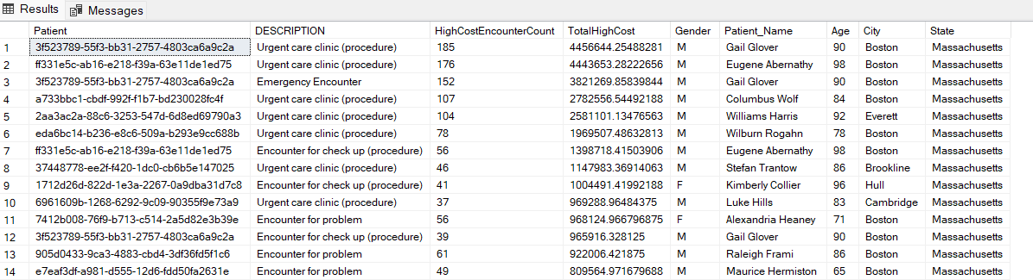
KEY INSIGHTS
2. Identifying Patients with Frequent High-Cost Encounters
A small group of elderly patients (mostly aged 80–100) in boston and cambridge have had 40–185 high-cost encounters, contributing over ₹4.4 million per patient.
Most of these encounters are labeled as “urgent care clinic” and “encounter for check-up”, suggesting potential overutilization of routine care with high billing

Slide 10
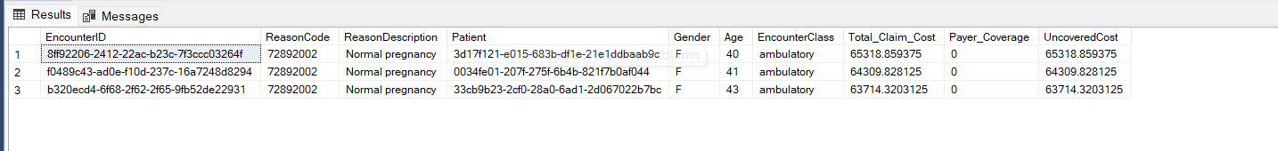
KEY INSIGHTS
3. Identifying Risk Factors Based on Demographics and Encounter Reasons
All high-cost encounters are tied to reasoncode 72892002 (normal pregnancy), occurring in female patients aged 40–43 within ambulatory care settings.
Each encounter had a total claim cost above ₹63k, with 0% payer coverage, meaning the entire cost is unpaid — a major financial risk.
This highlights a significant demographic risk: middle-aged females undergoing maternity care are facing complete coverage gaps, suggesting an urgent need to review maternal benefits and reimbursement policies.

Slide 11
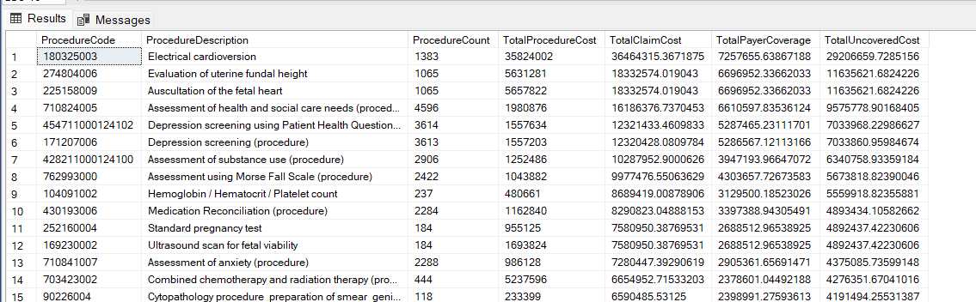
KEY INSIGHTS
4. Assessing Payer Contributions for Different Procedure Types
Procedures like electrical cardioversion and standard pregnancy tests show very high uncovered costs (₹29M+ and ₹4.8M+ respectively), with less than 20% payer coverage, suggesting poor reimbursement.
Despite high claim costs, routine screenings (e.g., Depression screening, anxiety assessment) are also underfunded, leaving ₹7M+ in uncovered expenses across thousands of procedures.
High-cost interventions like combined chemo-radiation therapy and cytopathology also face low coverage (<40%), indicating that even critical procedures are not adequately supported by payers.

Slide 12
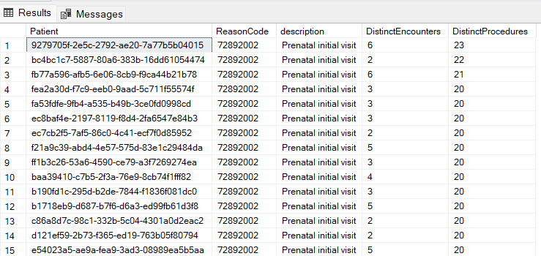
KEY INSIGHTS
5. Identifying Patients with Multiple Procedures Across Encounters
Patients with reasoncode 72892002 (prenatal initial visit) had multiple encounters (up to 6) and underwent 20+ distinct procedures, indicating a high volume of care per individual.
The majority of patients consistently received 20 or more procedures, even with as few as 2 or 3 encounters — signaling intensive diagnostic or monitoring practices during maternity care.
These repeated multi-procedure visits suggest a strong need for care pathway optimization to reduce overuse, and possibly bundle procedures for prenatal care to control costs and improve efficiency.

Slide 13
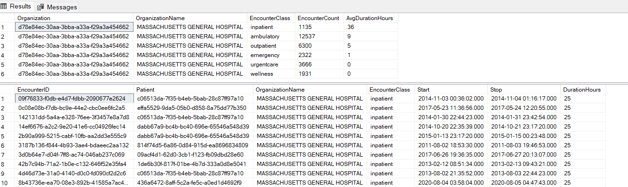
KEY INSIGHTS
6. Analyzing Patient Encounter Duration for Different Classes
Inpatient encounters at massachusetts general hospital had the longest average duration (36 hours) and over 1,100 cases, indicating significant resource usage.
Encounter types like ambulatory and outpatient had shorter durations (9 and 5 hours respectively), while urgent care and wellness encounters showed zero recorded durations, possibly due to missing or instantaneous records.
Multiple inpatient encounters exceeded 24 hours, confirming the need for careful monitoring and cost management of extended stays, especially in high-volume institutions.

Slide 14
Visual REPORT Requirement
1. Encounter Cost Distribution by Encounter Class
Objective: Analyze the distribution of base and total claim costs across different encounter classes (e.g., ambulatory, emergency, inpatient, wellness, urgent care).
2. High-Cost Patient Identification
Objective: Identify patients with repeated high-cost encounters and highlight their total cost contribution to the healthcare system. This helps in targeting care management for patients with high healthcare utilization.
3. Uncovered Costs by Payer and Reason Code
Objective: Analyze the financial risks due to uncovered costs, focusing on how much each payer is covering versus how much remains uncovered across different diagnosis or reason codes.
4. Procedure Cost Trends and Diagnosis Correlation
Objective: Explore trends in the cost of procedures performed over time and their correlation with specific diagnosis codes or conditions.
5. Geographical Analysis of Encounters by Organization and Cost
Objective: Map healthcare encounters geographically to identify regions or organizations with high patient traffic and high average encounter costs.

Slide 15
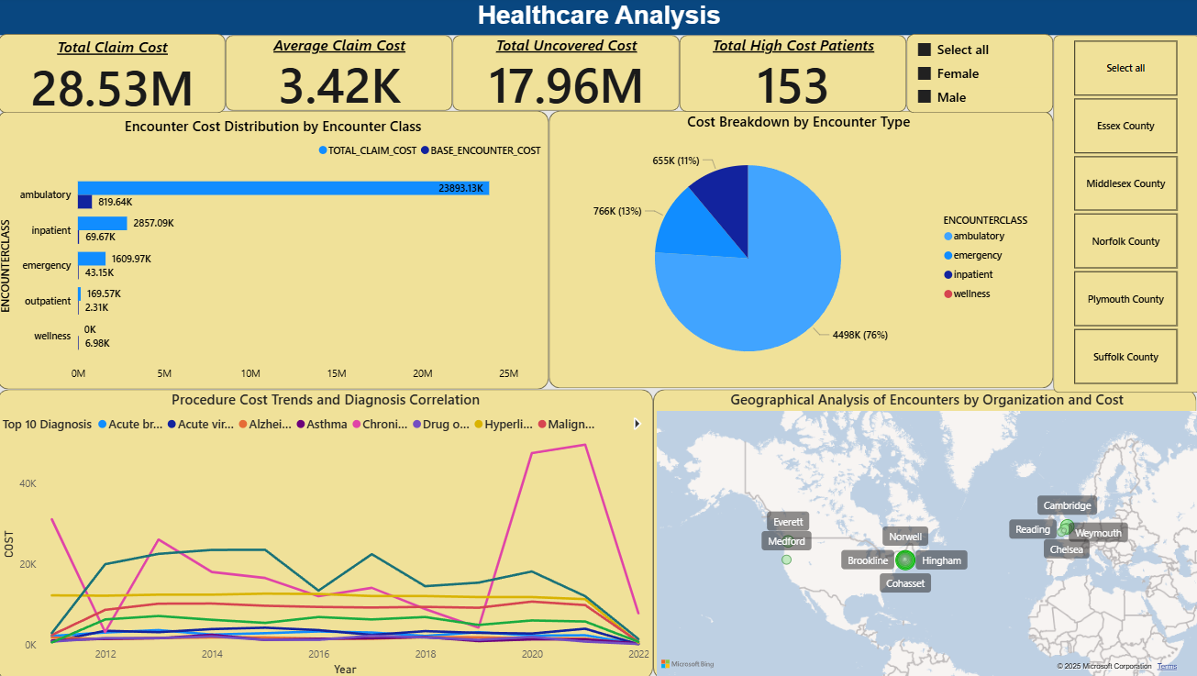
Visual Report

Slide 16
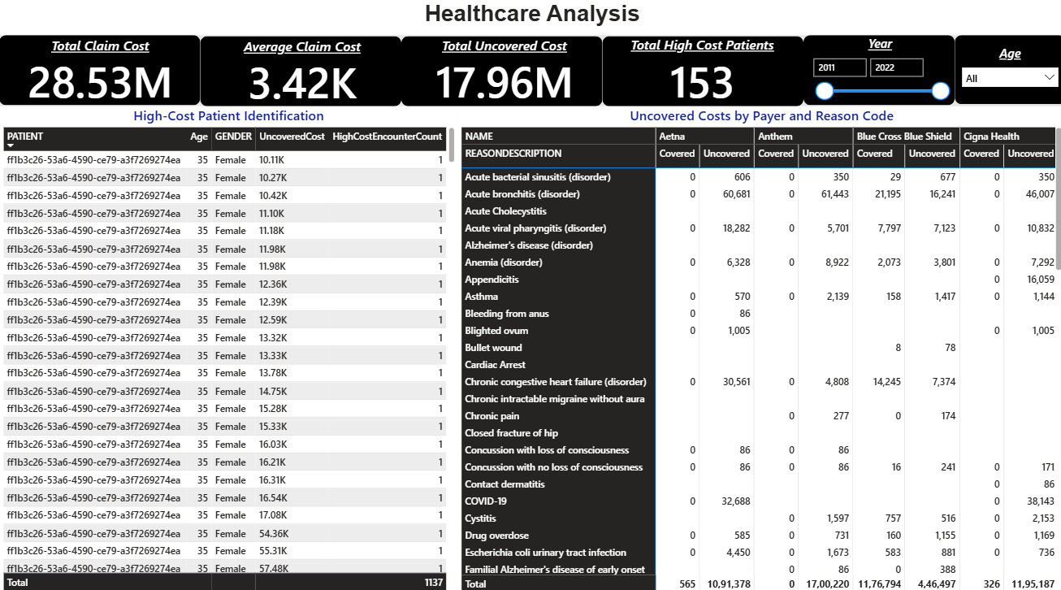
Visual Report

Slide 17
Visual Report Insights
KPI Insights
1. Total Claim Cost: ₹28.53M
The healthcare system incurred a total of ₹28.53 million in claims, reflecting the overall service burden across all encounter types and procedure
Average Claim Cost: ₹3.42K
The average cost per encounter is ₹3,420, which indicates that although many services are relatively affordable individually, their high volume (especially ambulatory) contributes significantly to total costs.
3. Total Uncovered Cost: ₹17.96M
A staggering ₹17.96 million remains unpaid by insurance payers, exposing providers to considerable financial risk — primarily due to gaps in coverage across chronic, maternal, and emergency care.
4. Total High-Cost Patients: 153
153 patients had repeated encounters each exceeding ₹10,000, flagging them as priority cases for care coordination and cost-containment strategies.

Slide 18
Visual reports & insights
Encounter cost distribution by encounter class ambulatory encounters account for the highest total cost (₹23.8M) despite low base costs, indicating high frequency. Inpatient and emergency visits show significantly higher base cost per visit, driving substantial overall spend.
High-cost patient identification 153 patients had repeated encounters with claim costs over ₹10,000, making them key contributors to total system expense. Many of these patients have 5–10+ high-cost visits, suggesting a need for targeted care management.
Uncovered costs by payer and reason code payers like anthem and cigna have consistently high uncovered costs across multiple diagnoses. Conditions like chronic heart failure and acute bronchitis show large gaps in payer coverage, posing financial risk to the provider.
Procedure cost trends and diagnosis correlation procedure costs for conditions like drug overdose and chronic illness show inconsistent but sharp increases over the years. Diagnoses such as asthma and alzheimer’s also reflect steady cost growth, signaling chronic care cost
Geographical analysis of encounters by organization and cost cities like cambridge, brookline, and everett report both high patient traffic and elevated average costs. Smaller regions (eg., Hingham, norwell) show fewer encounters but higher cost per visit, possibly due to emergency-only cases or limited care access."

Slide 19
Recommendations
Implement Care Management for High-Cost Patients → Focus on elderly or chronic condition patients with repeated high-cost visits to reduce readmissions and improve outcomes.
Review Coverage Gaps with Payers → Renegotiate contracts or adjust billing strategies for underfunded diagnoses and procedures (e.g., pregnancy care, chronic illness).
Bundle Ambulatory & Prenatal Procedures → Consolidate high-frequency procedures into cost-effective packages to control spending without reducing care quality.
Strengthen Preventive and Community Care Access → Reduce dependency on high-cost emergency services in regions with low encounter volume but high cost per visit.
Monitor Cost Trends Quarterly → Track spikes in procedure claims by diagnosis and region to proactively respond to cost surges.

Slide 20
Conclusion
The analysis reveals significant cost concentration in ambulatory, inpatient, and emergency care, with ambulatory visits accounting for the highest total expenditure due to volume.
A small group of 153 high-cost patients contributes disproportionately to total system costs, often with repeated visits exceeding ₹10,000 each.
Uncovered costs remain a major challenge, especially across diagnoses like chronic heart failure and with payers such as Anthem and Cigna, exposing providers to financial risk.
Procedure costs are rising sharply over time, particularly in chronic conditions and mental health, indicating increasing pressure on care budgets.
Geographical variation shows high-cost burdens are concentrated in urban areas (e.g., Cambridge, Brookline), while lower-volume regions still face elevated per-encounter costs due to emergency reliance.

Slide 21

Thank you
Adnan Shaik
+91 9951431138
adnanshaik1731@gmail.com

